Slide 1


Slide 2
CML: Control, Machine Learning and Numerics
Gradient Descent and Optimization in Deep Learning

Slide 3
Group Members
Debanjan Chakraborty
Md Ifraham Iqbal
Md Nazrul Islam
Orko Dutta
Sajal Das
Muhammed Muneeb

Slide 4
Introduction
Advancement in technology
Availability of data
Machine Learning and Data Analysis
Deep Learning and its benefits
Why Optimization is required in Deep Learning
Gradient Descent based Optimization
Which optimizer to use?
Motivation for this project

Slide 5
Previous Methods Contents
Gradient Descent
Stochastic Gradient Descent
Mini Batch Gradient Descent
Gradient Descent with Learning Rate Decay
Gradient Descent with Momentum
Nesterov Momentum
AdaGrad
AdaDelta
RMSProp
Adam
AMSGrad

Slide 6
Batch Gradient Descent
Batch gradient descent is used when the batch data contain all the training samples basically it applies a parameter update on each data point because we must compute the gradients for the whole dataset in order to execute a single update.
Batch Gradient Descent is great for convex or relatively smooth error manifolds. The equation is θ=θ−η∇(J(θ))
Pros and Cons
Some advantages of batch gradient descent are that it is computational efficient, It produces a stable error gradient and a stable convergence.
Some disadvantages are that the stable error gradient can sometimes result in a state of convergence that isn’t the best the model can achieve. It also requires the entire training dataset be in memory and available to the algorithm.

Slide 7
Stochastic Gradient Descent
SGD performs a parameter update for each training example x(i)x(i) and label y(i)y(i) is θ=θ−η.∇θJ(θ;x(i);y(i))
It does away with this redundancy by performing one update at a time. It is therefore usually much faster and can also be used to learn online.
It performs frequent updates with a high variance that cause the objective function to fluctuate heavily.
Pros and Cons
Some advantages are that the frequent updates allow us to have a pretty detailed rate of improvement. It is faster than Batch Gradient descent as it does not train the whole dataset.
Disadvantages are that the frequent updates, however, are more computationally expensive than the batch gradient descent approach. Additionally, the frequency of those updates can result in noisy gradients, which may cause the error rate to jump around instead of slowly decreasing.

Slide 8
Mini Batch Stochastic Gradient Descent
Mini-batch gradient descent finally takes the best of both Batch and Stochastic and performs an update for every mini-batch of nn training examples:θ=θ−η⋅∇θJ(θ;x(i:i+n);y(i:i+n))
It reduces the variance of the parameter updates, which can lead to more stable convergence and can make use of highly optimized matrix optimizations common to state-of-the-art deep learning libraries that make computing the gradient
A mini-batch very efficient. Common mini-batch sizes range between 50 and 256, but can vary for different applications.
Mini-batch gradient descent is typically the algorithm of choice when training a neural network and the term SGD usually is employed also when mini-batches are used.
Pros and Cons
Advantage is that it creates a balance between the robustness of stochastic gradient descent and the efficiency of batch gradient descent.
Disadvantage - It follows a zigzag Path to reach the local minimum therefore it produces noisey gradients.

Slide 9
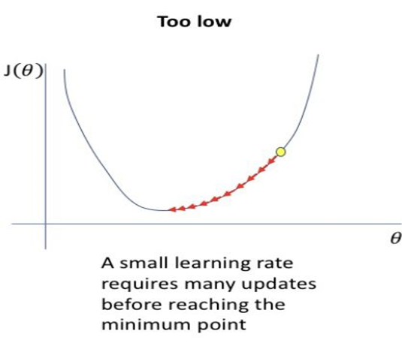
The problem of a fixed Learning Rate
While a learning rate that is to large can hinder convergence and cause the loss function to fluctuate around the minimum or even to diverge.

Slide 10
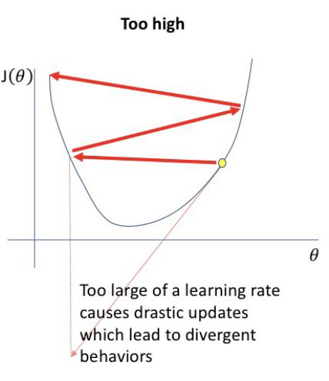
The problem of a fixed Learning Rate
Now these gradient descents, however, does not guarantee good convergence, but offers a few challenges that need to be addressed. Choosing a proper learning
rate can be difficult. A learning rate that
is too small leads to painfully slow
convergence.

Slide 11
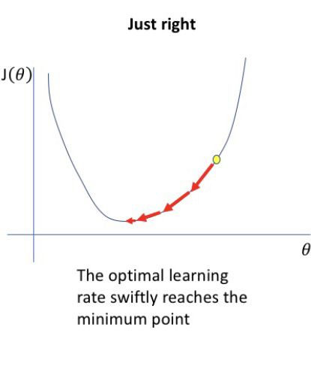
The Application of Learning Rate Decay
So, We use Learning rate schedules
try to adjust the learning rate during
training by e.g. annealing, i.e. reducing
the learning rate according to a predefined
schedule or when the change in objective
between epochs falls below a threshold.
These schedules and thresholds, however,
have to be defined in advance and are thus
unable to adapt to a dataset's characteristics.

Slide 12
Gradient Descent with Momentum
Build inertia in a direction in the search space
Overcome the drawbacks of previous methods
Accelerate the optimization process
Improve the capability of the optimization algorithm
Tendency to overshoot

Slide 13
Nesterov Momentum
Resolves the issue of overshooting.
Here the gradient term is not computed from the current position θt in parameter space but instead from a position θintermediate= θt+μ*vt
it first makes a big jump in the direction of the previous accumulated gradient and then measures the gradient where it ends up and makes a correction.
But with some cons, It works better when there is a higher value of decay rate (μ) and higher number of parameters is used which lead us to more time consuming

Slide 14
Adagrad
Adagrad is an optimizer with parameter-specific learning rates, which are adapted relative to how frequently a parameter gets updated during training.

Slide 15
Adagrad
Previous Methods: Same Learning rate 𝜂 for all parameters 𝜃
Different learning rate for every parameter 𝜃 at every time step t
Adagrad adapts the learning rate to the parameters
Large updates for infrequent parameters
Small updates for frequent parameters
Divides the learning rate by the square root of the sum of squares of historic gradients
Force the algorithm to make updates to the weights in each spatial dimension with the same proportions.

Slide 16
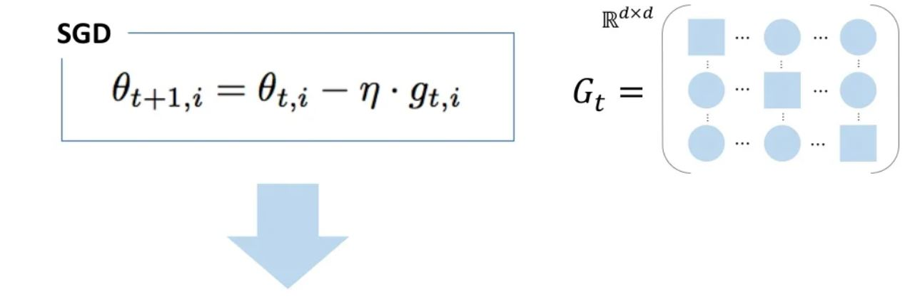
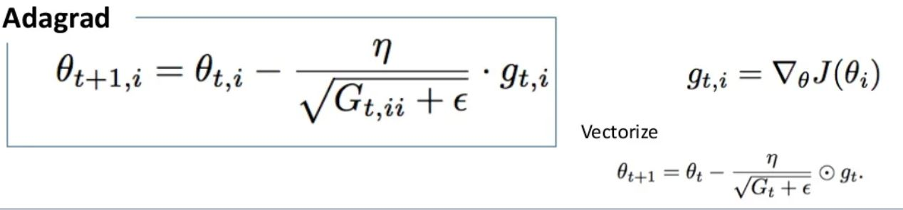
Adagrad

Slide 17
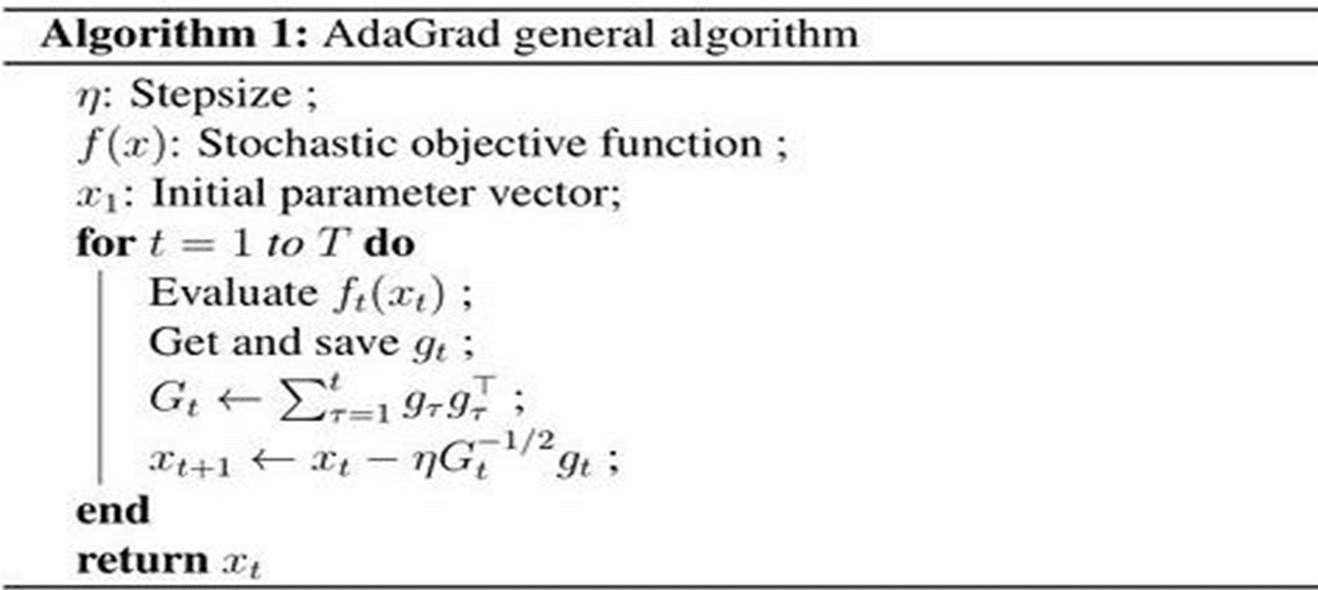
Adagrad Algorithms

Slide 18
Adagrad
Advantage
It is well-suited for dealing with sparse data
It greatly improved the robustness of SGD
It eliminates the need to manually tune the learning rate
The learning rate is automatically updated. There is no need to manually update the learning rate for each feature.

Slide 19
Adagrad
Disadvantage
Main weakness is its accumulation the squared gradients in the denominator
A squared term is added for each iteration. Since it is always positive, the learning rate constantly decreases and can become infinitely small.

Slide 20
AdaDelta
An extension of AdaGrad to reduce its monotonically decreasing learning rate

Slide 21
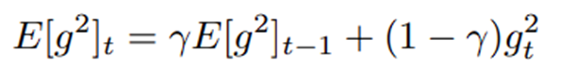
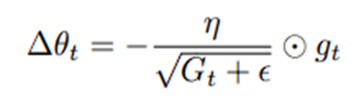
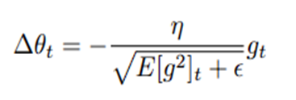
AdaDelta
Accumulates exponentially decaying average of the squared gradients
where γ is 0.95
Parameter update vector from Adagrad
Replace diagonal matrix (G _{t}) with decaying average over past squared gradients

Slide 22
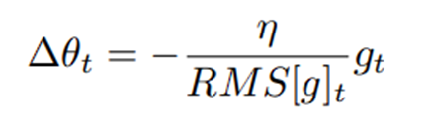
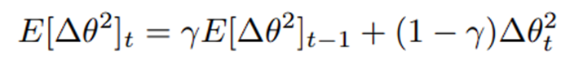
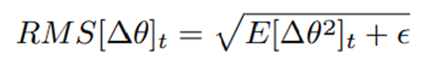
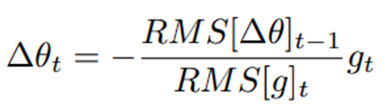
AdaDelta
As denominator is the root mean squared (RMS) error criterion of the gradient
Exponentially decaying average of squared parameter updates
RMS error of parameter updates
Replace learning rate η with RMS[∆θ]_{t−1}

Slide 23
AdaDelta
Why AdaDelta?
Overcomes the disadvantage of Adagrad
Does not store all the previous squared gradients
Restricts the window of accumulated previous gradients to some fixed size “w
Learning rate does not become too small
Decreases computational time

Slide 24
RMSPROP
RMSprop, is an extension of gradient descent and the AdaGrad version of gradient descent that uses a decaying average of partial gradients in the adaptation of the step size for each parameter.

Slide 25
RMSPROP
RMSprop is designed to accelerate the optimization process, e.g. decrease the number of function evaluations required to reach the optima
Improve the capability of the optimization algorithm, e.g. result in a better final result.
RMSprop optimizer is similar to the gradient descent algorithm with momentum.
RMSprop optimizer restricts the oscillations in the vertical direction. Therefore, we can increase our learning rate and our algorithm could take larger steps in the horizontal direction converging faster.

Slide 26
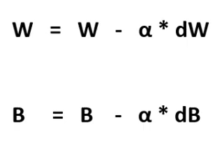
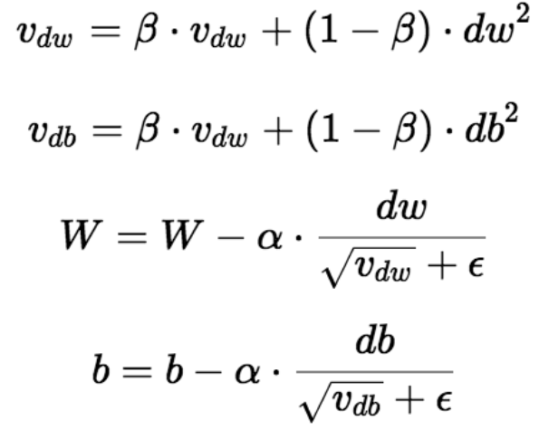
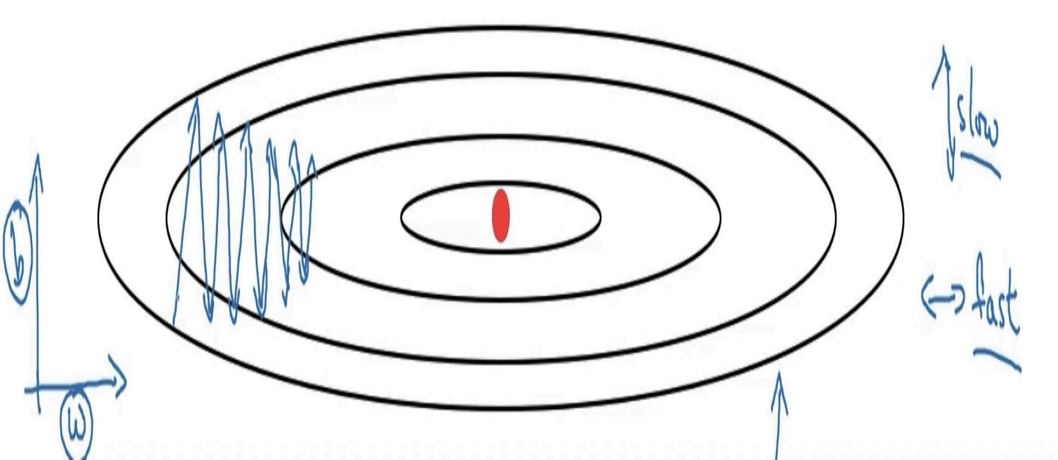
RMSprop
Gradient descent:
RMSprop’s update rule:

Slide 27
Adaptive Moment Estimation
AdaGrad + RMSProp +Bias Correction
High order gradients not suited to data with many parameters
First order Gradient Descent based optimization
Requires less memory
Combination of AdaGrad and RMSProp
AdaGrad has no bias correction
RMSProp with momentum is similar to Adam. Suffers from no bias correction

Slide 28
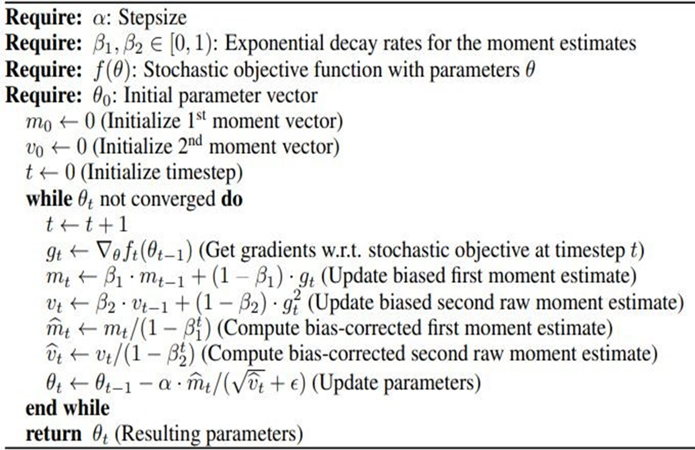
The Algorithm
Recommended Parameters:
α = 0.001
β1 = 0.9
β2 = 0.999
eta = 10^-8

Slide 29
Experimental Results
Logistic Regression
AdaGrad outperforms SGD with Nesterov Momentum
Adam converges as fast as Adagrad
Adam uses sparse features to obtain convergence faster
Multi Layer Neural Networks
Adam converges faster than SFO and other stochastic first order methods
Convolutional Neural Networks
Initially, Adam and AdaGrad is faster
Adam and SGD converge the fastest
Adapts learning rate for different layers instead of manual selection in SGD

Slide 30
Adam and its effectiveness
SGD uses a single learning rate for all weight updates
Adam adapts the learning rates using the moments
β1 and β2 control the decay rates
Bias correction prevents divergence
Adam is effective with tiny gradients(saddle points) due to bounded step sizes
SGD struggles in this case
In some cases SGD still performs better than Adam (CIFAR)
SWATS method is effective in this case
The V value in Adam can act weird in some scenarios
Hence, AMSGrad is proposed to avoid non-increasing step size

Slide 31
What is Adam Optimization Algorithm?
Used instead of the classical stochastic gradient descent procedure to update network weights iterative based on training data.
Adam combines the best properties of the AdaGrad and RMSProp algorithms to provide an optimization algorithm that can handle sparse gradients on noisy problems.

Slide 32
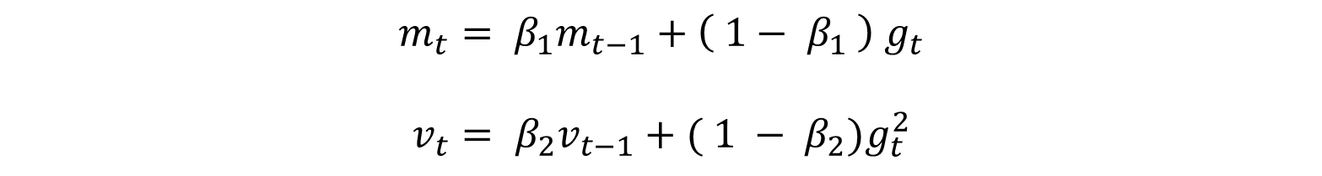
Steps for Adam Optimization Algorithm.
Step 1 : Calculation of moving averages using parameters.
$$m_{t}= β_{1}m_{t−1}+\left( 1− β_{1} \right) g_{t}$$
$$v_{t}= β_{2}v_{t−1}+( 1 − β_{2})g_{t}^{2}$$
Beta 1 and beta 2 are the exponential decay of the rates for the first moment estimates and the second moment estimates and it’s literature values are 0.9 and 0.999.

Slide 33
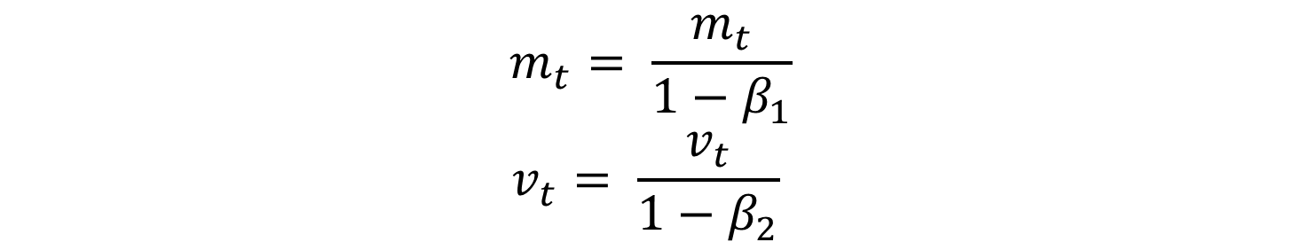
Steps for Adam Optimization Algorithm
Step 2 : Bias correction of the moving averages.
$$m_{t}= \frac{m_{t}}{1−β_{1}}$$
$$v_{t}= \frac{v_{t}}{1−β_{2}}$$
Given iteration t, we can calculate the moving averages based on parameters beta 1, beta 2 and gradient gt.

Slide 34
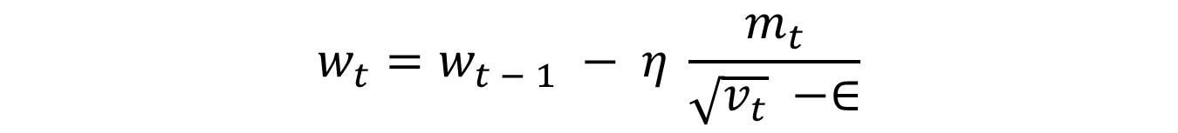
Steps for Adam Optimization Algorithm
Step 3 : Update the parameters based on the calculated moving averages with a step size.
$$w_{t}=w_{t − 1} − η \frac{m_{t}}{\sqrt{v_{t}} −∈}$$
Where 𝜂 is the step size for moving averages

Slide 35
AMSGrad Contents
Gradient Descent.
What is the Adam Optimization Algorithm?
Steps for Adam Optimization Algorithm.
What is AMSGrad?
Steps for AMSGrad Optimization Algorithm.
AMSGrad Optimization Algorithm for different variable functions with examples.

Slide 36
What is AMSGrad?
AMSGrad is an extension to the Adam version of gradient descent.
Attempts to improve the convergence properties of the algorithm.
Avoiding large abrupt changes in the learning rate for each input variable.

Slide 37
Steps for AMSGrad Optimization Algorithm
AMSGrad is an extension of Adam in which we have one extra step. It uses the maximum of past and current square of gradients which we will call second-moment hat. All others steps are the same.
We calculate ‘learning rate hat’ as follow:
𝑙𝑒𝑎𝑟𝑛𝑖𝑛𝑔_𝑟𝑎𝑡𝑒=𝑙𝑒𝑎𝑟𝑛𝑖𝑛𝑔_𝑟𝑎𝑡𝑒∗ √(1 − 𝛽_2^(𝑖+1) )/(1 − 𝛽_1^(𝑖+1) )
Where beta 1 and beta 2 are decay rates for the first and second moment respectively, and ‘I’ is the iteration loop index starting from 0.
Then calculate update as follow:
𝑢𝑝𝑑𝑎𝑡𝑒=𝑙𝑒𝑎𝑟𝑛𝑖𝑛𝑔_𝑟𝑎𝑡𝑒 ∗𝑚_𝑡/(√(𝑣_𝑡 )+∈)

Slide 38
Algorithm for different variable functions with examples.
AMSGrad Algorithm for 1 variable:
Let us define a function and its derivative and we start from x = -1.
𝑦=𝑓(𝑥)=𝑥 − 𝑥^3
𝑑𝑦/𝑑𝑥= 𝑓^′ (𝑥)=1 −3𝑥^2

Slide 39
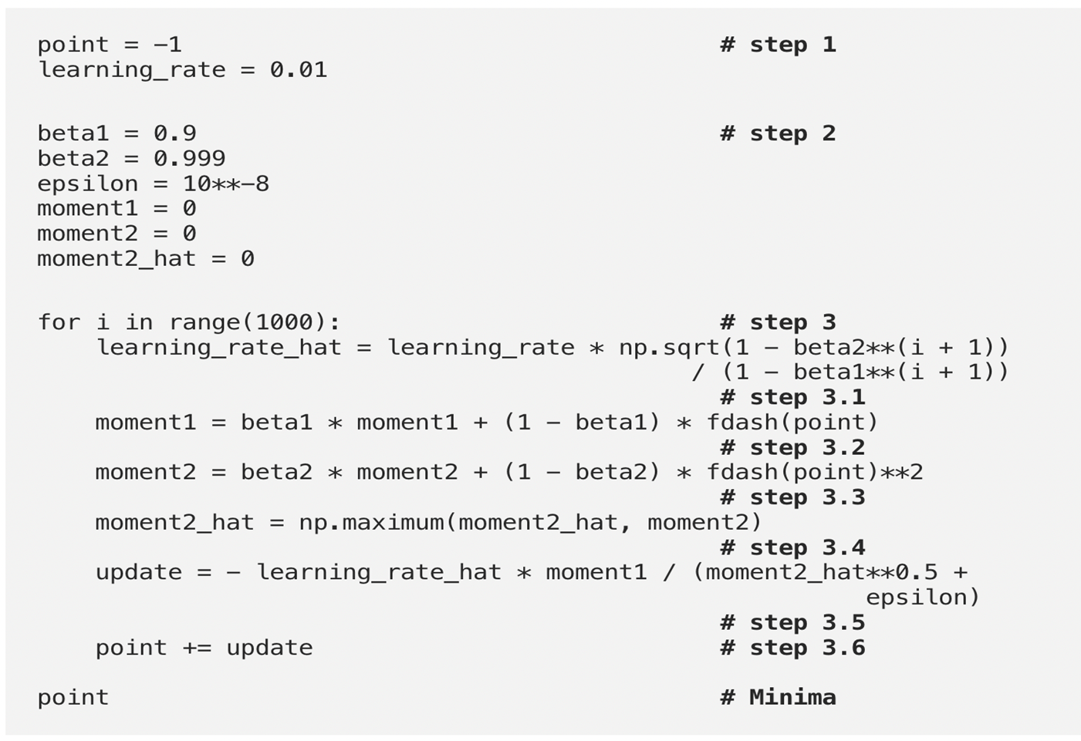
Algorithm

Slide 40
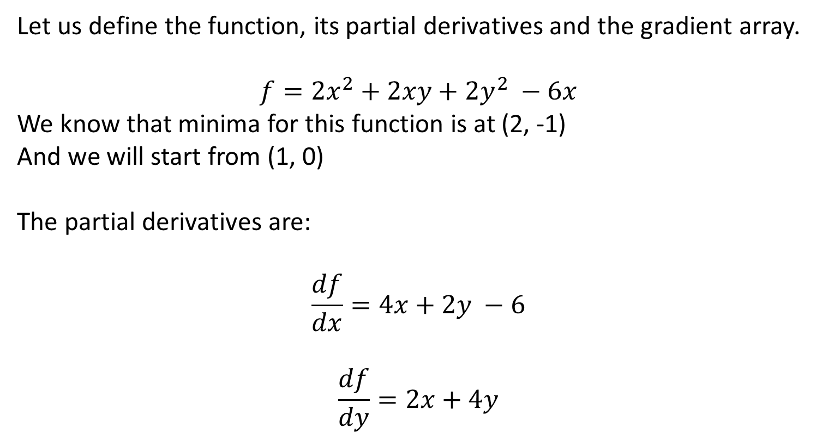
AMSGrad in multi-variable function :
Let us define the function, its partial derivatives and the gradient array.
$$f=2x^{2}+2xy+2y^{2} −6x$$
We know that minima for this function is at (2, -1)
And we will start from (1, 0)
The partial derivatives are:
$$\frac{df}{dx}=4x+2y −6$$
$$\frac{df}{dy}=2x+4y$$

Slide 41
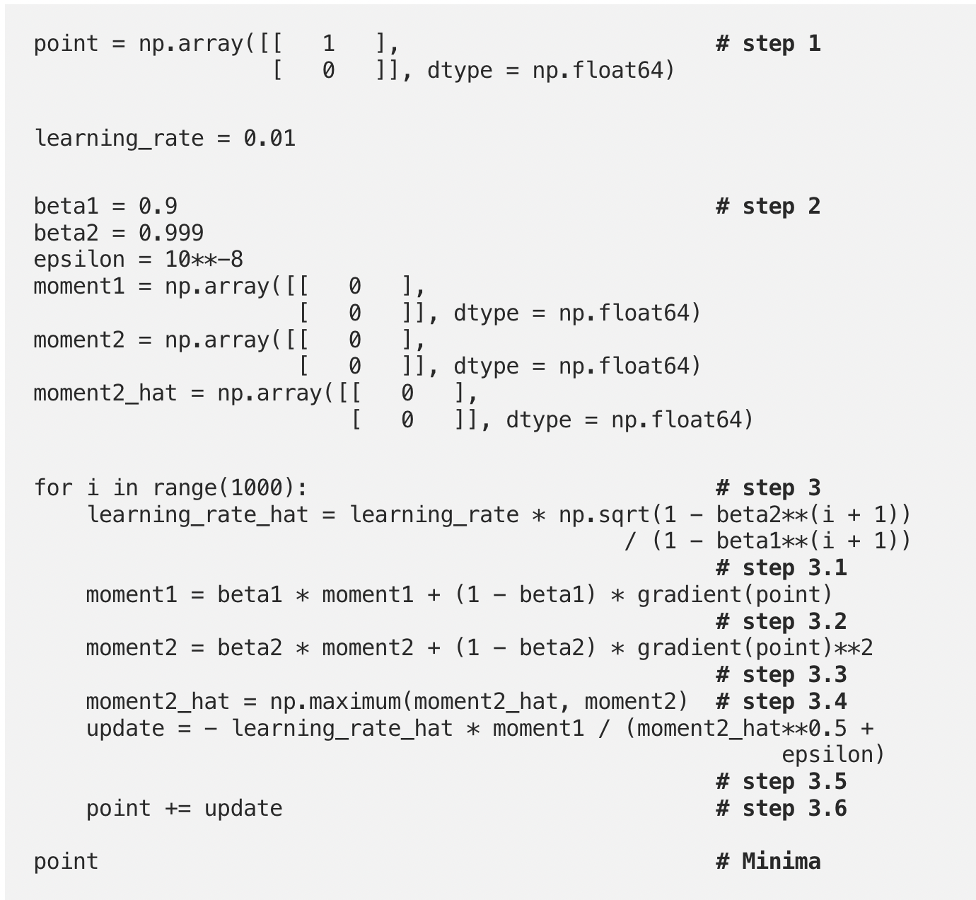
Algorithm

Slide 42
Other Algorithms
Nadam
Weight Decay with Adam
ND-Adam

Slide 43
Our experiment results
Optimizer | Epoch Number |  |  |  |  | Best Validation Accuracy
 | 1 | 2 | 3 | 4 | 5
SGD with ELRD | 0.6668 | 0.5895 | 0.5340 | 0.5246 | 0.5213 | 0.8666
Sgd with Momentum | 0.6412 | 0.5280 | 0.4657 | 0.4609 | 0.4609 | 0.8500
Sgd with Momentum+ELRD | 0.6717 | 0.5303 | 0.4550 | 0.4435 | 0.4412 | 0.8500
AdaGrad | 0.3654 | 0.0199 | 0.0048 | 0.0037 | 0.0030 | 1.000
Adadelta | 0.5165 | 0.1199 | 0.0333 | 0.0258 | 0.0202 | 0.7333
RMSProp | 0.7167 | 0.5117 | 0.0221 | 0.0046 | 0.0025 | 1.000
Adam | 0.3223 | 0.0002 | 0.0001 | 0.0001 | 0.0001 | 1.000
Adamax | 0.3536 | 0.1020 | 0.0020 | 0.0011 | 0.0011 | 1.000

Slide 44
Summary
SGD with Nesterov Momentum and Learning Rate Decay
Converges most reliably
Many parameters to adjust
Adam
Adapted learning rates
Still not as reliable as SGD
Loss curves are hard to interpret due to learning rates

Slide 45
Our Recommendations for Optimizers
Start with Adam (Default Parameters)
Adjust the learning rate
Try AMSGrad and other variants of Adam
Use SGD with Momentum
Use AMSGrad if Adam does not work
Combine SGD and Adam with SWATS

Slide 46
Hypothesis of automation of the Optimizer parameters

Slide 47
Conclusion

Slide 48
Contribution

Slide 49
References
https://towardsdatascience.com/how-to-implement-an-adam-optimizer-from-scratch-76e7b217f1cc
https://medium.com/@neuralthreads/amsgrad-a-variant-of-adam-using-the-maximum-of-past-square-gradients-544a9cc84619
https://medium.com/@neuralthreads/amsgrad-a-variant-of-adam-using-the-maximum-of-past-square-gradients-544a9cc84619

